Slide 1
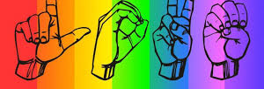
Charades
Ramsha Rasheed Fa16- BCS-127
Aisha Fa16-bcs-097
Bilal ahmed fa16-bcs-121
Supervisor
Dr. Usama Ijaz Bajwa

Slide 2
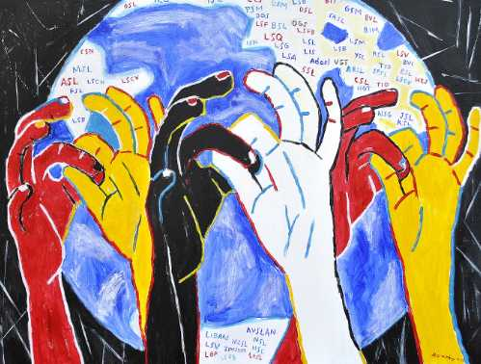
Introduction
Charades is a virtual sign language interpreter.
Android application.
Accommodates 2-way communication:
Sign-to-Text
Text-to-Sign

Slide 3
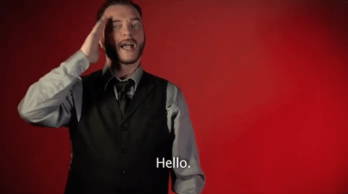
How do deaf communicate?
Through sign language.
Abled people have no knowledge of sign language.
Use professional interpreters to communication.

Slide 4

Problem
Sign language interpreter :
Expensive
Not accessible at all time.
Automated translators present for almost all the languages.
Google translate
No automated translator available for sign languages.
This causes a communication gap for > 466 million people around the world (432 million adults and 34 million children).

Slide 5
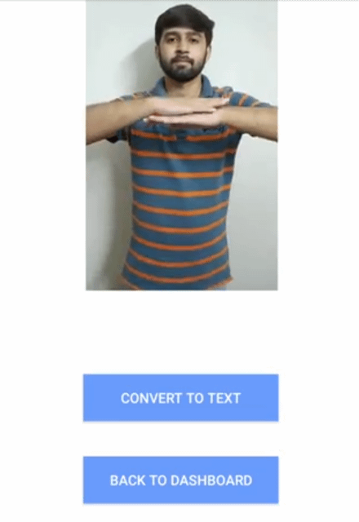
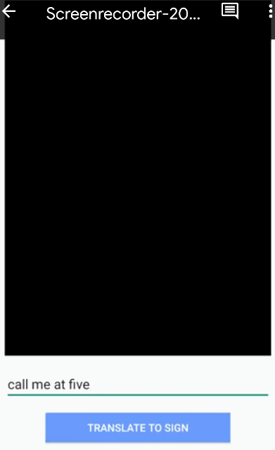
Features
Detects the sign performed by deaf person through camera
Translating signs into equivalent English sentence.
Abled person typing the English sentence for translation.
English sentence converted into corresponding signs and displayed on screen.

Slide 6
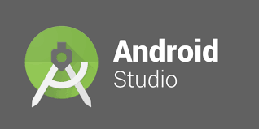

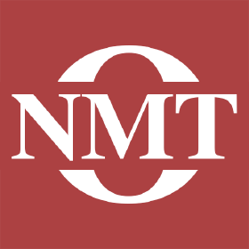

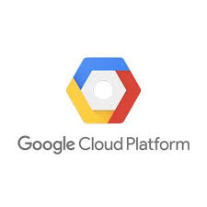
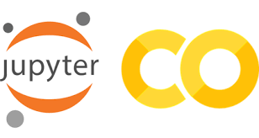
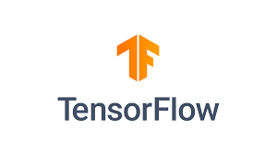
Tools and Techniques

Slide 7
Related work
Augmented reality app that converts sign to speech and vice versa.
Not publicly available.
Only makes doctors appointments.
KinTrans
Uses stationed camera for recognition.
SignAll
Uses 4 cameras and installed in a booth.

Slide 8
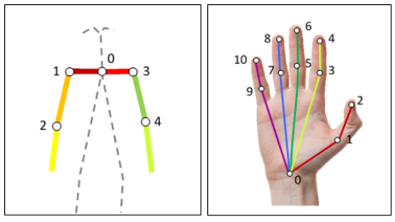
ASLLVD dataset The dataset focuses on 27 key points for sign language recognition and production.
Notes:
Our dataset focuses on these 27 key points in sign language recognition and production. Few of the key points are on face too. 11 for each hand and 5 for shoulder and arms.

Slide 9
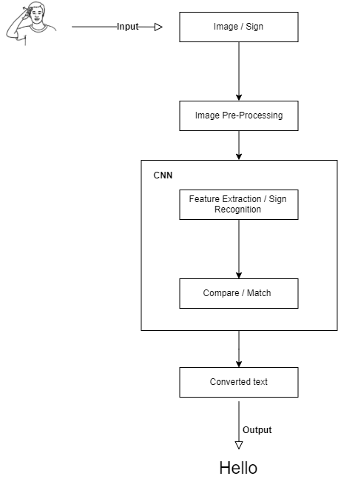
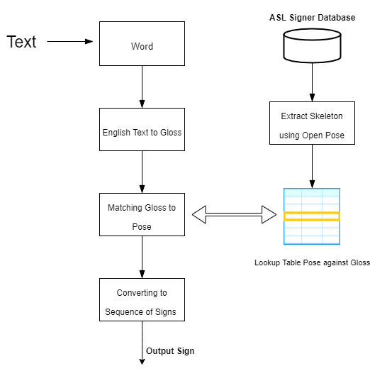
Sign-to-text
Text-to-sign

Slide 10
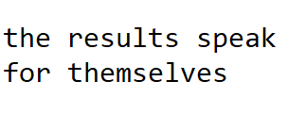
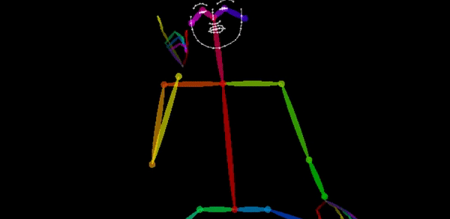
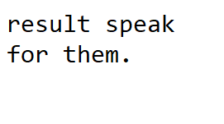
Text-to-Sign Module
Pipeline
Model
Lookup table
English
Gloss
Pose

Slide 11
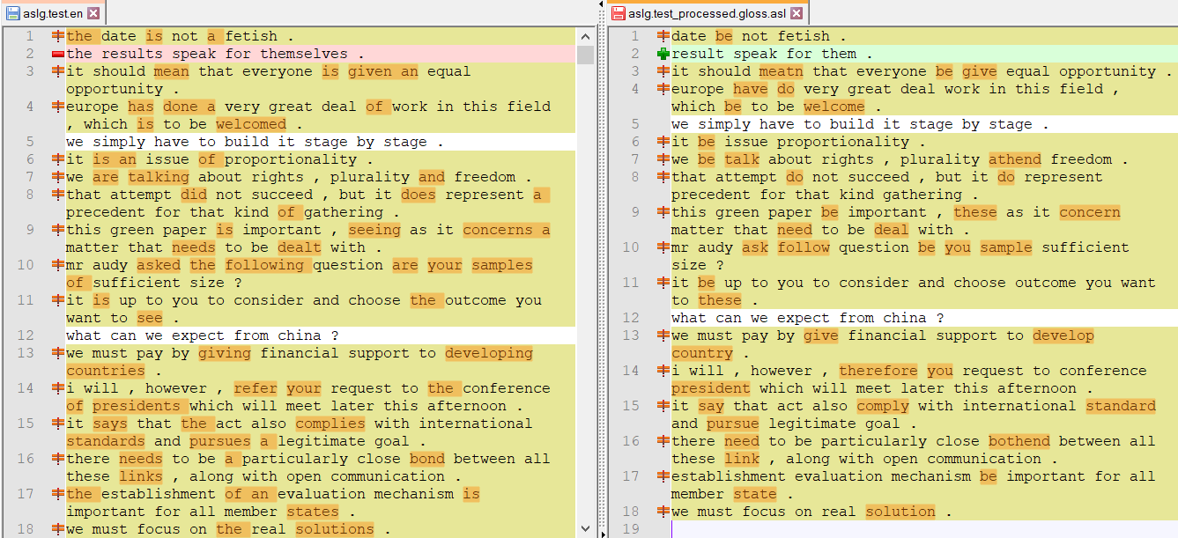
English-ASL Gloss Parallel Corpus 2012(83K examples)
Gloss = written form of sign language

Slide 12
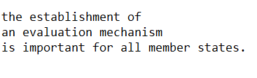
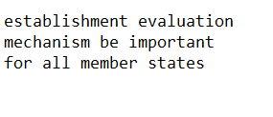
English → Gloss
Transformer model with shared GloVe Embedding, different number of heads and model dimension
English sentences
ASL Gloss
Sequence to sequence

Slide 13
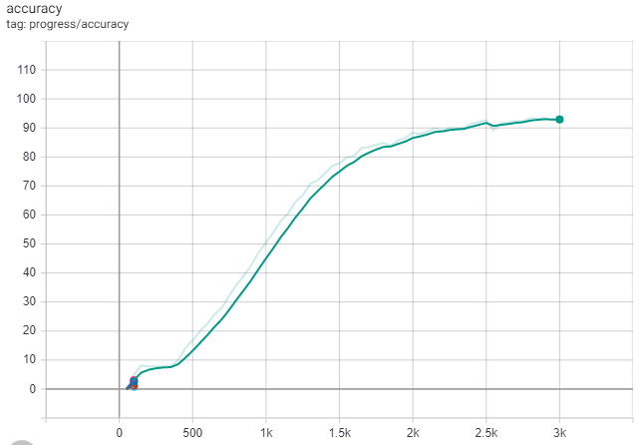
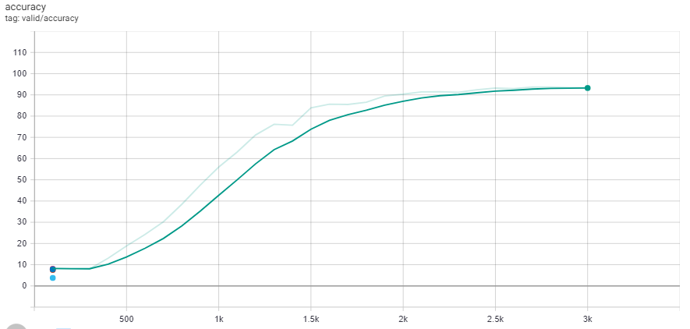
Training accuracy
Validation accuracy

Slide 14
English → Gloss
BLEU evaluation matric is used.
Score is between 0 to 1 or sometimes normalized from 0 to 100.
Usually calculated on ~1000 sentences.
Notes:
BLEU(bilingual evaluation understudy) is an algorithm for evaluating the quality of text which has been machine-translated from one natural language to another.

Slide 15
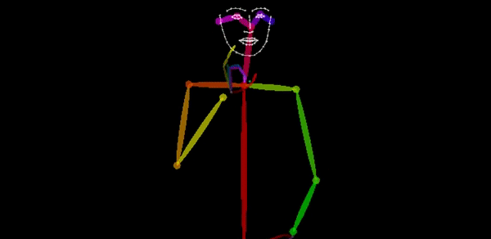
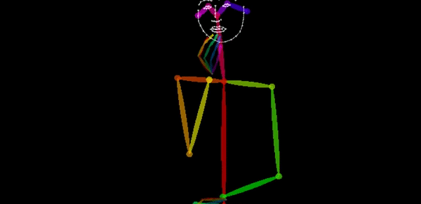
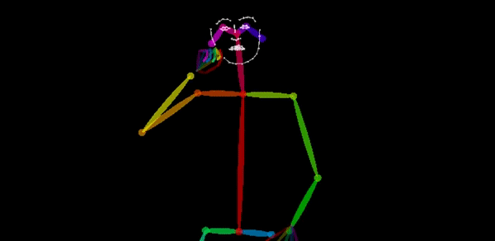
Gloss → Pose
I + ate + an apple
I + eat + apple
→
→

Slide 16
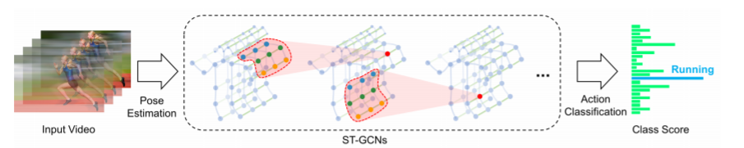
Sign-to-Text module
Pipeline
Sign in video
feature extraction
English word

Slide 17
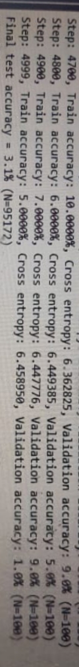
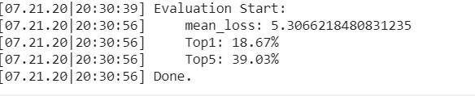
Evaluation results for 2745 classes using st-gcn model
Evaluation results for 2745 classes using CNN+RNN model
Notes:
Top 1 model’s accuracy and the top-5 accuracy, which corresponds to the accuracy based on the five most likely responses presented by the model

Slide 18
SWOT analysis
Strength
Easy to use.
Real-times translations.
Both way translation possible.
Weakness
Takes more than a minute to translate.
Recognition probability is less.
Opportunity
Can integrate more sign languages.
Increase accuracy by getting improved dataset.
Threats
Dataset availability
Lack of computational resources
Funding problems

Slide 19
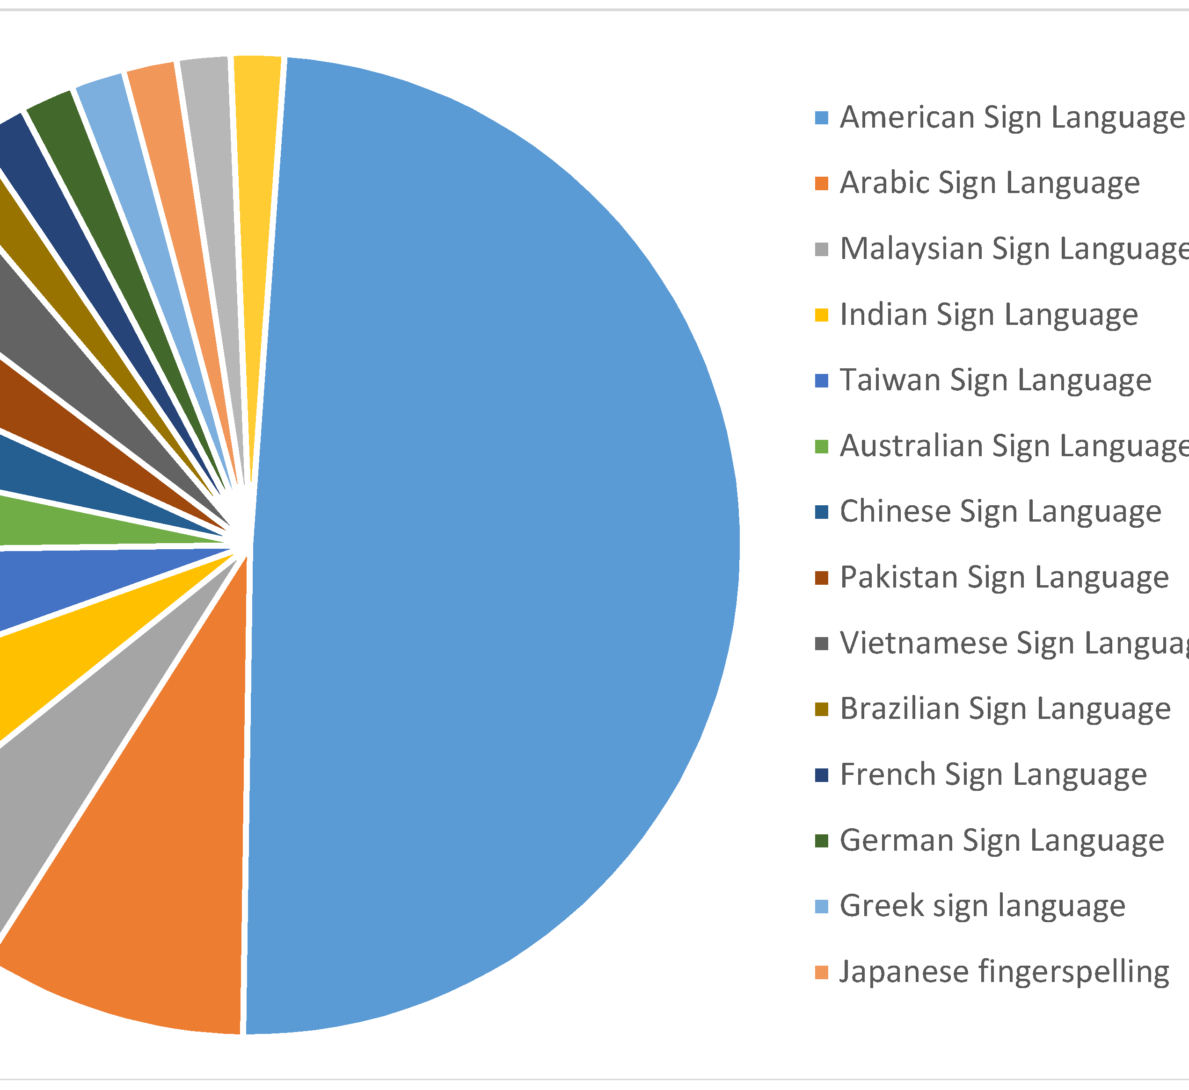
Challenges
Choosing sign language to target
International sign language not officially declared yet.
ASL most widely spoken among others.
Notes:
English-ASL gloss public datasets are small (< 100,000 sentence pairs) and of poor quality

Slide 20
Challenges
Technical challenges
For text-to-sign
Modern translation models use hundreds of millions of examples English-ASL gloss public datasets are small (< 100,000 sentence pairs) and of poor quality and the sentences were not all parallel.
Dataset was reviewed sentence by sentence to make it accurate.
Speed of video dataset was reduced.
For sign-to-text
ASLLVD dataset only has frontal view of the signer.
2D frontal view of signer was used for recognition and production .

Slide 21
Challenges
Engineering Challenges:
Computational extensive:
Sign-to-text model requires a Nvidia GPU with extensive memory for demo.
For overall project, a server system with good GPU and extensive memory is required.
Google Colab and Google cloud platform were used for training and testing purposes.

Slide 22
Challenges
Android application
Cannot work with .mov extension videos.
Video dataset of 9745 videos was converted to .mp4
Can not port heavy models on android device.
The models along with dataset were ported on local flask server.

Slide 23
Thank You!

Slide 24
GitHub Links
https://github.com/mishu45/CharadesFYP

Slide 25
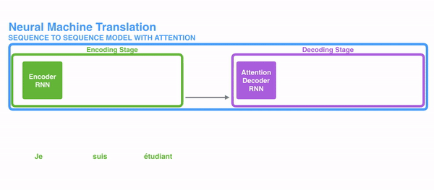
Sequence to sequence

